Slide 1

COVID 19 BED DISTRIBUTION SYSTEM
Sayali Mahajan - NUID 00176540
Gayatri Degaonkar - NUID 001095613
Aishwarya Deshpande - NUID 001003135

Slide 2
About Our System
The Covid Bed Distribution System provides a robust multi-party digital platform for the ongoing COVID-19 pandemic.
The application provides patients with facility of introducing all the hospitals having beds available, in their particular network.
The patient can decide one hospital out of all those hospitals they wants to get admitted to, according to the availability.
Hospitals can request new Camp sites to be operated under them, when they run out of available beds to admit patients.

Slide 3
Problem Statement
Our system provides patients with an important facility of getting admitted to hospital they desire to, with safety and assurance.
COVID-19 positive patients can search for beds in their network and can request for a bed to Hospitals.
If hospitals have no available beds left, they can request for New Camp sites to NGOs.
NGOs help hospitals find Camp sites available by requesting Camp Admins for the same. Hospitals can expand their functionality by adding new Camps under their organization.
Once the patient's request to get admitted Hospital/ Camp is accepted, they are picked up from their house and are brough to Hospital/ Camp safely.

Slide 4
Issues Addressed
In the pick time of this pandemic, we observed that large number of people were getting affected with Virus and hospitals were getting filled with patients and there were no new beds available for more patients to be admitted.
The patients were left deprived of proper treatment to overcome the disease and get cured properly.
Many of the patients suffered long term symptoms, pains, and some death.
This application provides Patients with list of Hospitals having beds available in their area.
It helps patients select particular Hospital and arrive at Hospital safely and securely by taking all the care.

Slide 5
Extra Features
Call notification to the Emergency contact person provided by the patient
Email notification to the users after the registration
Bar graph
Pie chart
Image upload and view functionality

Slide 6
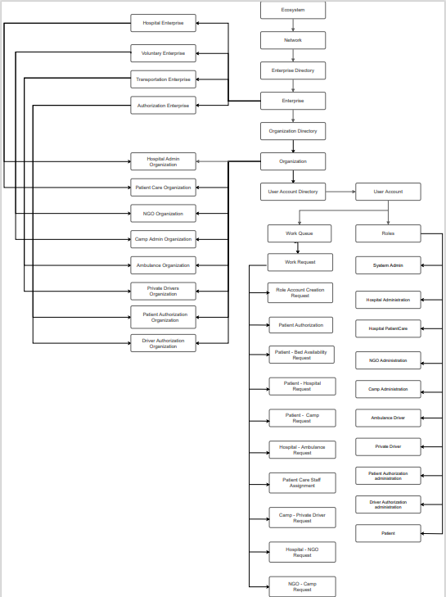
Object Model

Slide 7
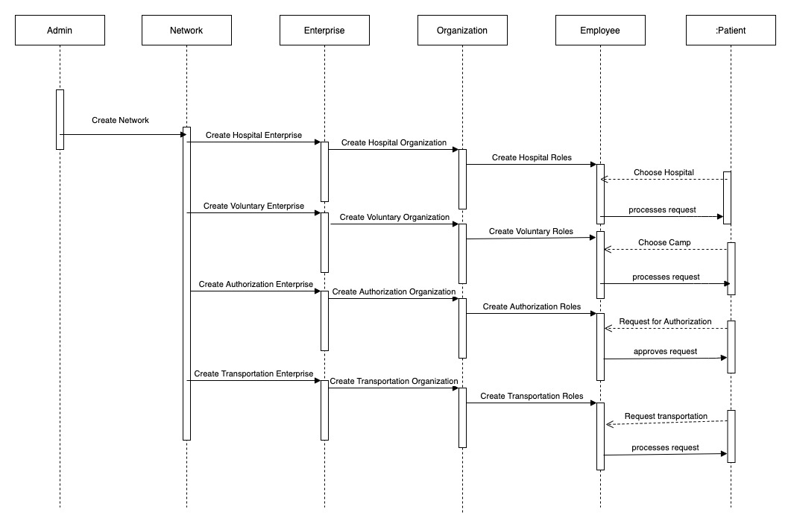
Sequence Diagram

Slide 8
Roles and Responsibilities
SYSTEM ADMIN: The responsibility of this admin is to create Networks, Enterprises and Enterprise admins.
HOSPITAL ADMIN: The responsibility of this admin is to approve patient requests, assign ambulance and patient care staff to the patient. This admin can also create new Camp site under their organization to extend their functionality.
PATIENT: Patient can request for Hospital or Camp to get admitted into. Before that they have to upload valid Covid-19 test report and get authorized. Once their request to get admitted is approved, they can arrive to Hospital/ Camp by Ambulance with Patient Care Staff.

Slide 9
Roles and Responsibilities
PATIENT AUTHORIZATION ADMIN: This admin checks valid Covid-19 report submitted by Patient and approves it by checking it.
AMBULANCE DRIVER: Ambulance driver will be assigned to particular Patient by Hospital admin after they approve Patient. Ambulance driver will pick up the Patient along with Patient Care Staff and bring them to destined Hospital.
PATIENT CARE STAFF: Patient Care Staff will be assigned to particular Patient by Hospital admin after they approve Patient. Patient Care Staff will pick up the Patient from their address along with Ambulance, take care of Patient while they arrive at Hospital.
NGO ADMIN: NGO admin will receive requests from Hospitals for new Camp Sites. They will search for Camp lists that are available for set up and will request them accordingly.

Slide 10
Roles and Responsibilities
CAMP ADMIN: Camp Admin will receive requests from NGOs for new Camp setup. Once they accept the request, new Camp will be created with Beds capacity for Patients to get admitted. This Camp will be operated under particular Hospital that requested for the Camp.
PRIVATE DRIVER: Private driver will be assigned to particular Patient by Camp admin after they approve Patient. This driver will pick up the Patient along with Patient Care Staff of their original Hospital and bring them to destined Camp.
PRIVATE DRIVER AUTHORIZATION ADMIN: This authorization admin will receive requests from Private Drive to get authorized. He can check the driving license of Driver and approve them.

Slide 11
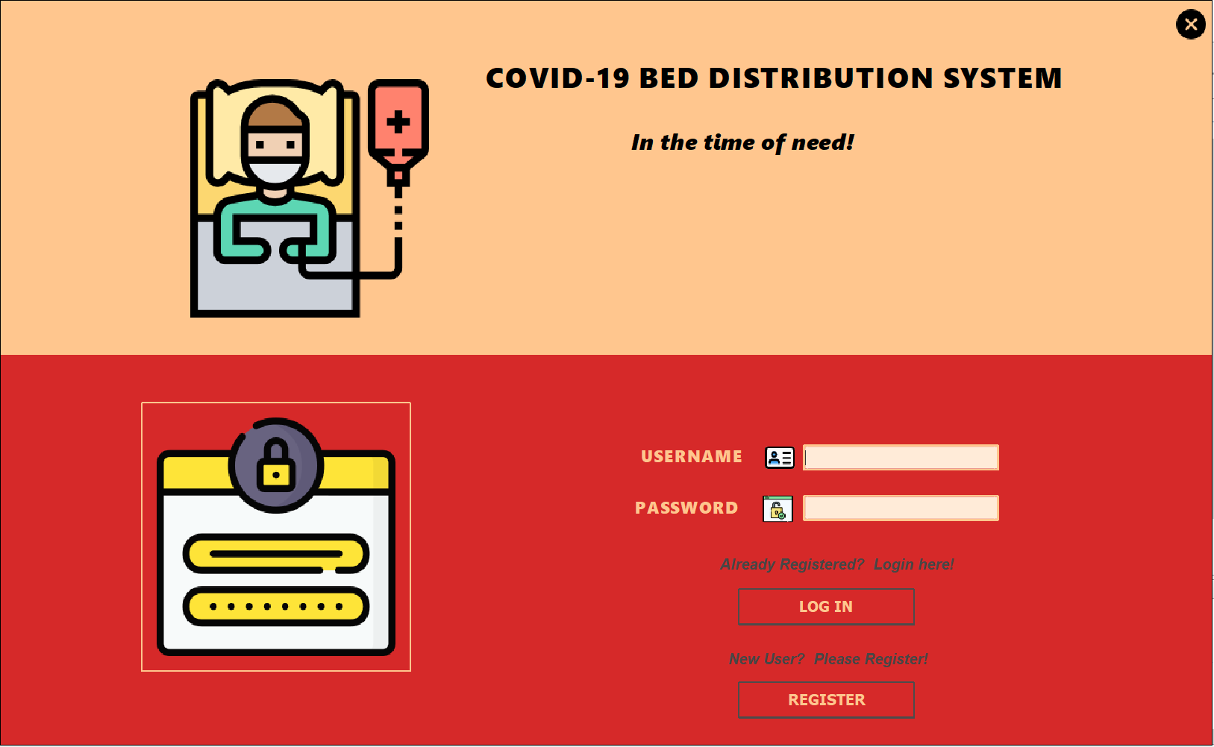
Home Page

Slide 12

System Admin

Slide 13
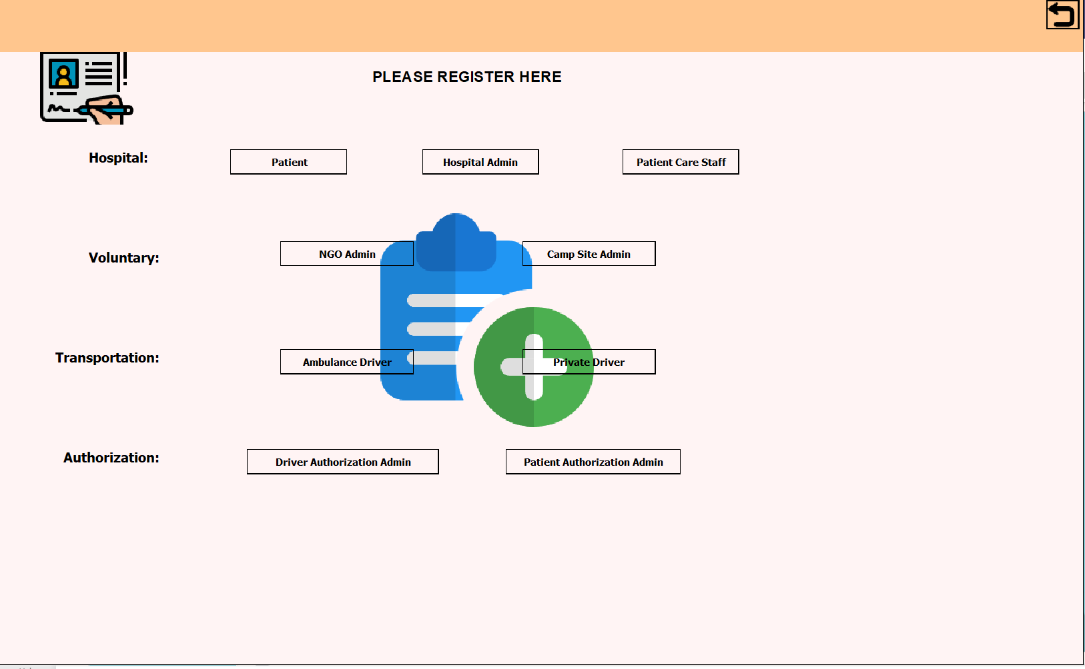
User Registration Page

Slide 14
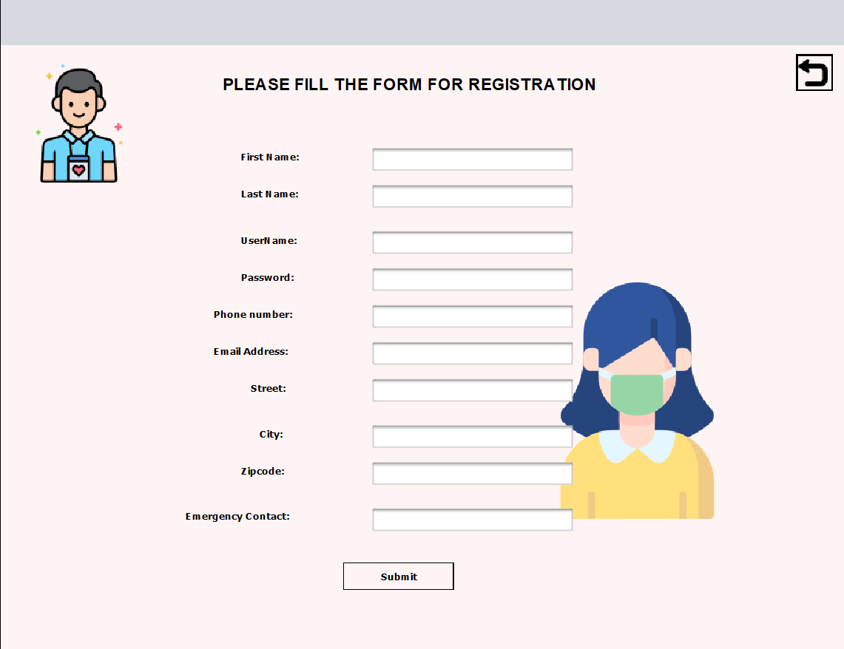
User Registration Page

Slide 15
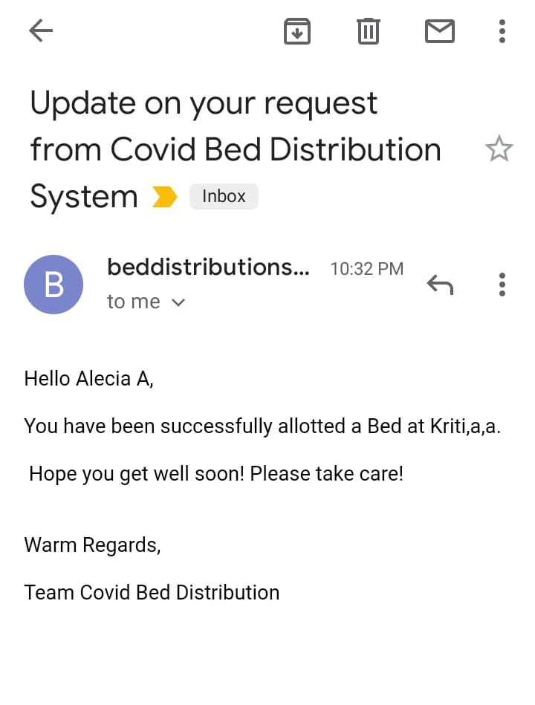
Email Notification

Slide 16
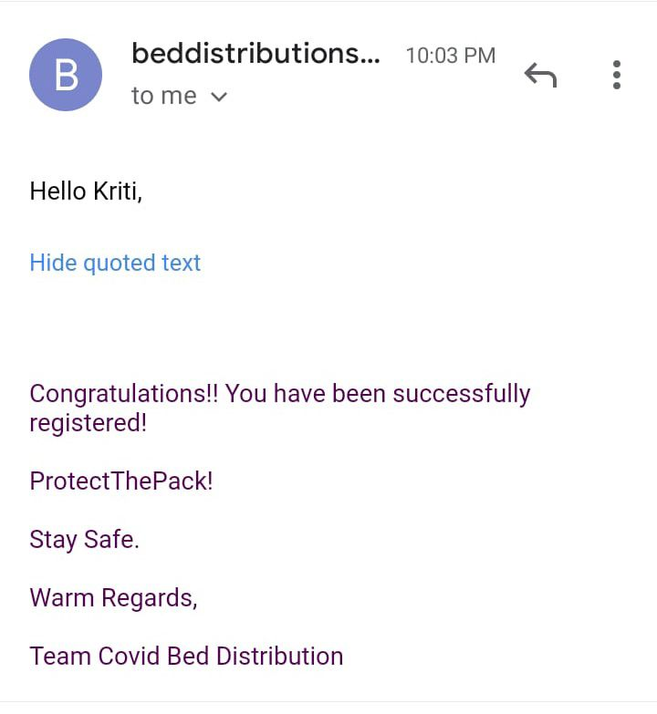
Email Notification

Slide 17
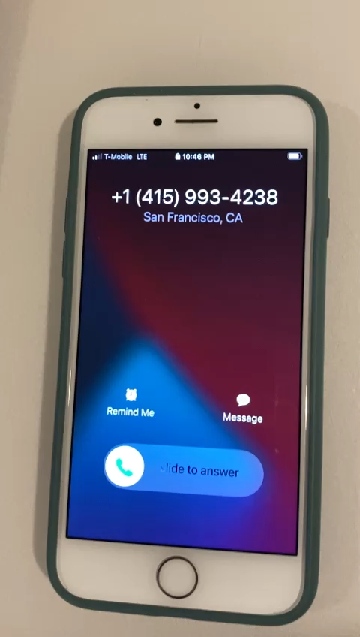
Call Notification

Slide 18
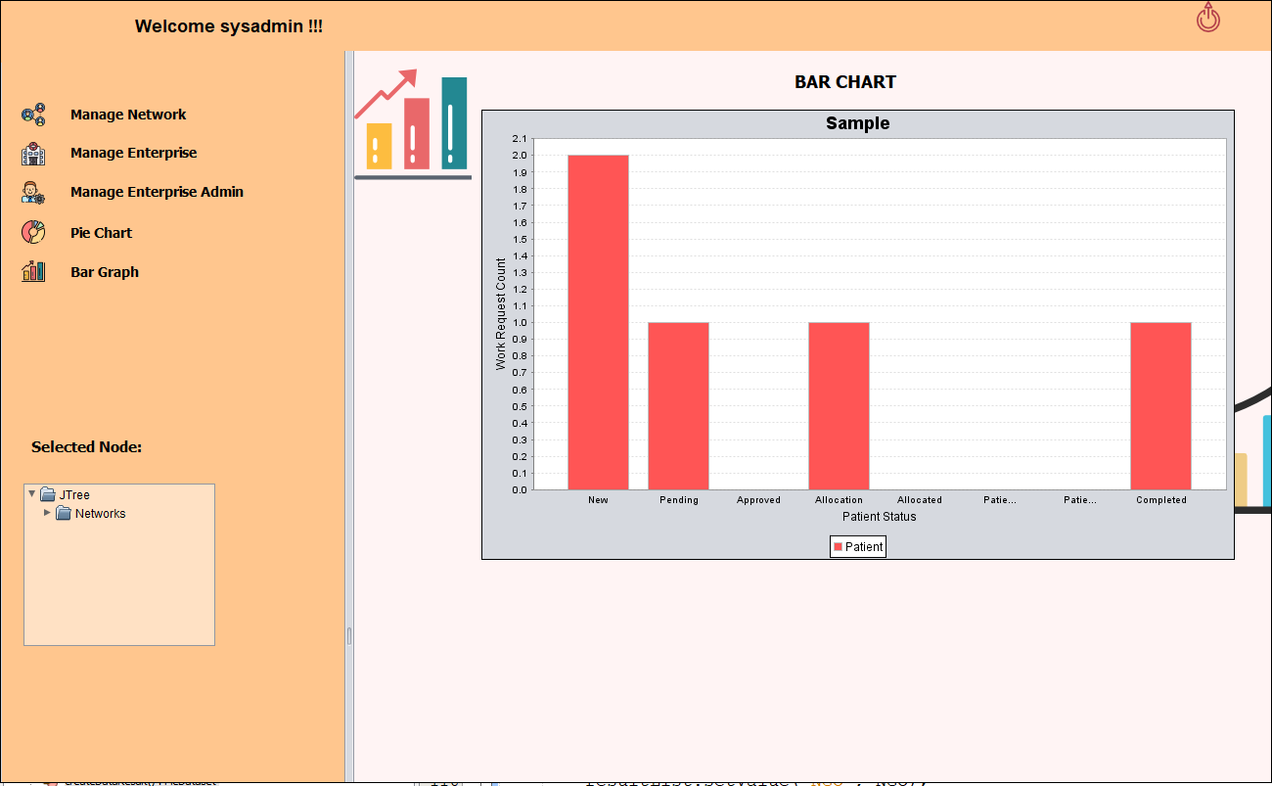
Bar Graph

Slide 19
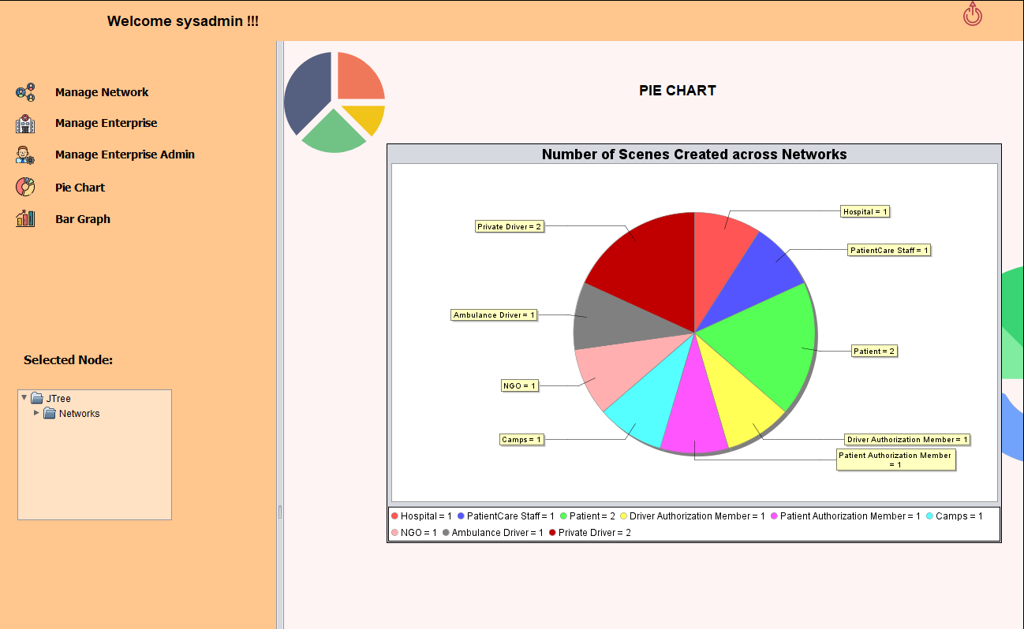
Pie Chart

Slide 20
DEMO

Slide 21
Thank You!!

